Slide 1
Microsoft Azure
Infrastructure as a Service
Dale Kirby – Cloud Solution Architect
Notes:
(Introductions and set expectations that this presentation is designed to discuss the role of Azure as the cloud computing platform for a business’s digital transformation.)

Slide 2
Agenda
Compute
Network
Storage
Management and Monitoring
Key Workloads
Notes:
-try to feel out crowd for azure experience
-how many have customers that already use azure?
-how many have azure certs?

Slide 3
Some Azure Trivia …

Slide 4
During the Sochi Olympics how many simultaneous online users watched the USA/Canada Hockey Game via Azure?
2.1 Million
Notes:
Sochi 2014 Olympics USA/Canada Hockey largest live cloud-delivered event
2.1 Million simultaneous users
Rio 2016 Olympics largest live cloud-delivered event in history

Slide 5
How many HD Blu Ray DVD’s could travel across the Azure network every second?
7000 (that is 72+ Tb per second backbone)
And FYI that is 25% more bandwidth than AWS
Notes:
-discuss azure dark fiber backplane, all owned by MSFT

Slide 6
How many times could the Microsoft Fiber Optic Network that connect our Azure datacenters stretch to the moon and back?
3
We now have over 1.6 M miles of fiber between our Azure datacenters

Slide 7
In general, do we cool our Azure Data Centers?
No!
http://www.datacenterknowledge.com/archives/2016/09/27/latest-microsoft-data-center-design-gets-close-to-unity-pue
Notes:
No raised floor anymore

Slide 8
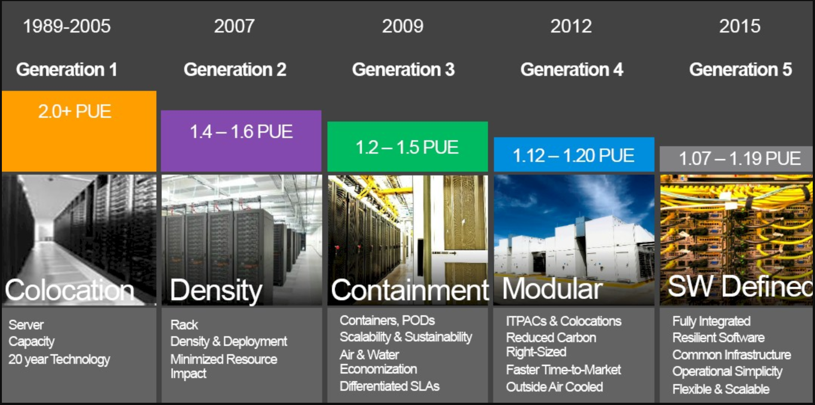
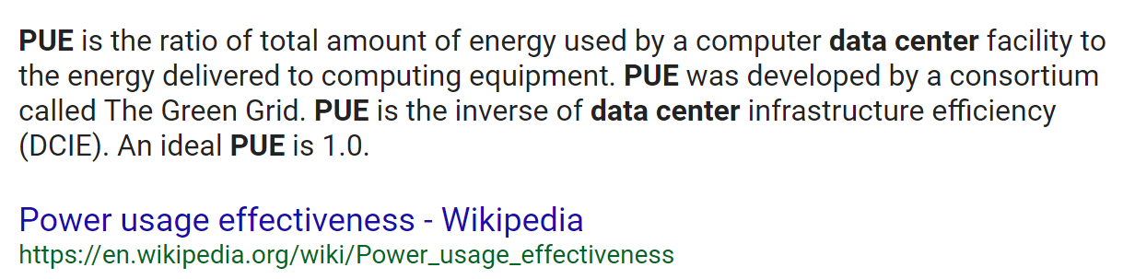

Slide 9

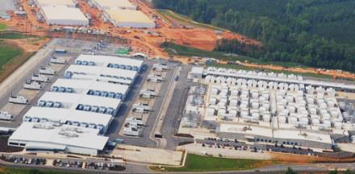
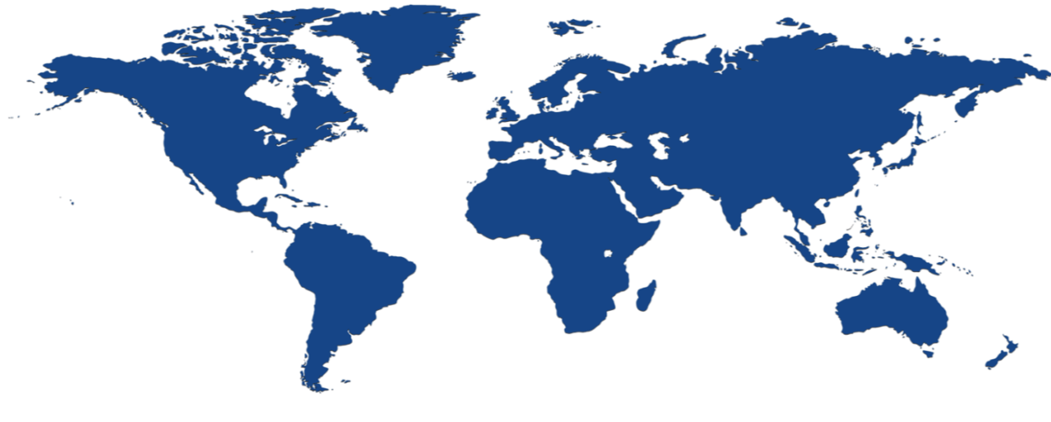
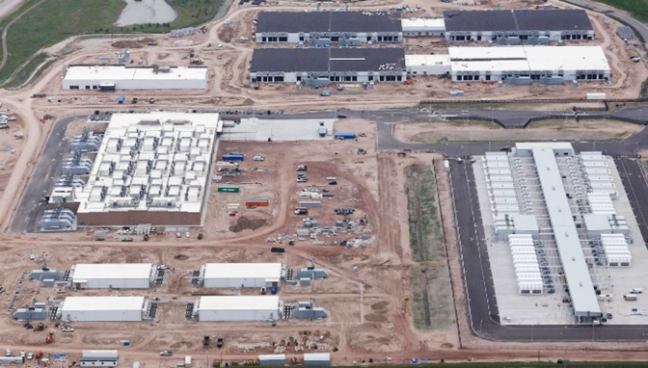



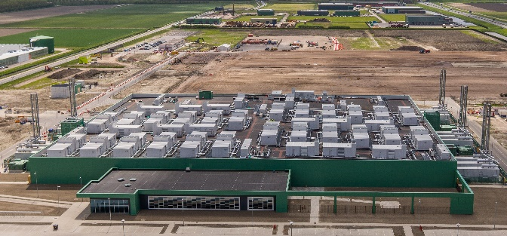
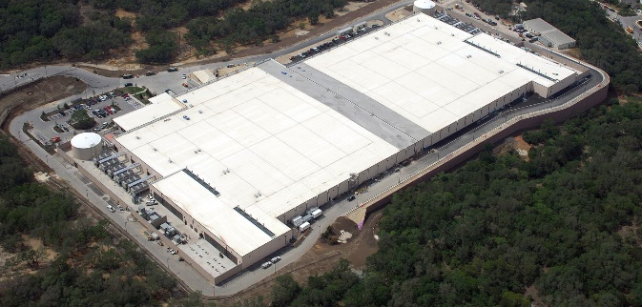



Microsoft infrastructure investments
40 Cloud regions worldwide
United Kingdom South
North Central US
United Kingdom West
West Europe
West US 2
Central US
Canada Central
Germany Northeast²
US Gov
Canada East
North Europe
Korea Central³
France³
Germany Central²
Korea South³
West US
East US
France³
China West¹
Japan East
US DoD West³
Japan West
West Central US
East US 2
China East¹
US Gov
West India
South Central US
US DoD East³
East Asia
Central India
South India
100+ datacenters
and
Millions of Servers
Southeast Asia
Brazil South
Australia East
Australia Southeast
Global datacenters
Sovereign datacenters

Slide 10
Regions paired for geo-redundancy
Designed for high data availability, resiliency against regional disasters
Geo-replicated data still within national boundaries for 8 countries
> 300 miles
US West
US
East
Geo replication
Notes:
Additionally, data is asynchronously copied to another datacenter that’s at least 400 miles away.
So you can be sure that every piece of data that you store in the Azure Blob is available as well as protected against regional disasters (we call this geo-replication).
Geo replication is a unique feature, that differentiates us from competition.

Slide 11
What percentage of new workloads in Azure are Linux?
50+%
30% of the workloads run Linux today, and growing 2x compared to Windows
Notes:
Rio 2016 Olympics largest live cloud-delivered event in history
Sochi Olympics USA/Canada Hockey largest live cloud-delivered event
2.1 Million simultaneous users

Slide 12

Azure + Open Source Momentum
Azure is a strong platform for Open Source
1 in 3 VMs on Azure are Linux
Linux VMs are growing at ~2 times Windows VMs today
~60% of 3rd party Azure Marketplace images are OSS
Majority of the VM’s in Azure China and Germany are Linux
>50% of all Azure consumption will be driven by Linux/OSS….

Slide 13
Cloud Computing Models
On-Premises
( Private Cloud )
Infrastructure
( as a Service )
Platform
( as a Service )
Software
( as a Service )
You Manage
You Manage
Data & Access
You Provision & Manage
Data & Access
Data & Access
Data & Access
You Provision & Manage
Applications
Applications
Applications
Applications
Provisioned & Managed by Vendor
Runtime
Runtime
Runtime
Provisioned & Managed by Vendor
Runtime
Operating System
Operating System
Operating System
Operating System
Virtual Machine
Virtual Machine
Virtual Machine
Virtual Machine
Physical Fabric Managed by Vendor
Compute
Microsoft
Provisions
Compute
Compute
Compute
Networking
Networking
Networking
Networking
Storage
Storage
Storage
Storage
Host
Develop
Consume
Notes:
(Adjust timing to Audience)
Slide Objective: Explain the commonly accepted cloud computing models (IaaS, PaaS, and SaaS) in terms of an IT Pro’s responsibilities.
Key Talking Points:
When considering these cloud computing models, skilled IT Pros are needed to manage the components of each model that are unique to an organization:
(CLICK) Infrastructure as a Service: While the cloud vendor manages the physical hardware fabric for raw compute, networking and storage capacity, (CLICK) IT Pros provision IaaS for their organizational needs and (CLICK) continue to manage each provisioned virtual machine in a manner that is very similar to on-premises workloads.
(CLICK) Platform as a Service: In PaaS, the cloud platform vendor provisions and manages a consistent runtime environment upon which applications can be developed. (CLICK) IT Pros are needed in deploying and monitoring these applications, as well as managing access and protection of data.
(CLICK) Software as a Service: In SaaS, an organization is consuming an entire packaged application that is being delivered via the cloud. (CLICK) IT Pros are needed to manage access to these applications and the underlying data.
By choosing the best cloud computing model for each application need, depending on whether your organization needs to host, develop or consume an application, IT Pros can gain significant time-savings when managing applications that can then be applied to time investments in new strategic projects for an organization.

Slide 14
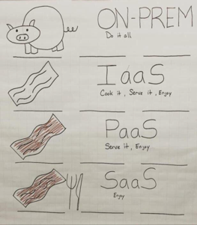

Slide 15












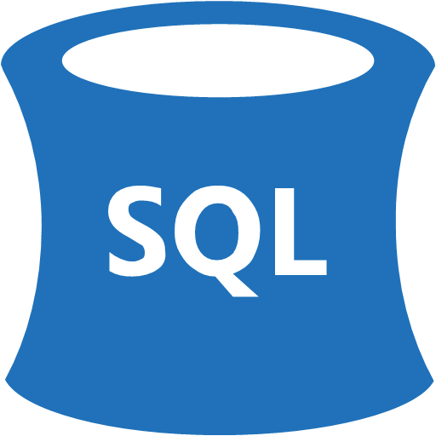





















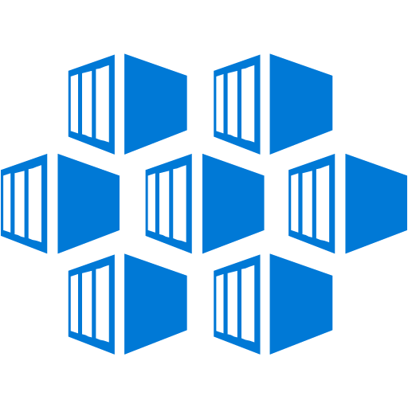

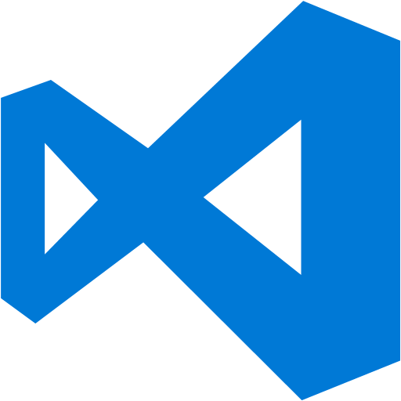




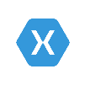






















Platform Services
Security & Management
Hybrid
Cloud
Media & CDN
Application Platform
Data
Security Center
SQL
Database
Azure AD
Health Monitoring
Media Services
Media Analytics
Content Delivery
Network
Web
Apps
Mobile
Apps
SQL Data
Warehouse
DocumentDB
Portal
AD Privileged
Identity
Management
Azure Active
Directory
Integration
SQL Server
Stretch Database
Redis
Cache
Storage
Tables
Azure
Search
API
Apps
Cloud
Services
Azure AD
B2C
API
Management
BizTalk
Services
Domain Services
Service
Fabric
Notification
Hubs
Intelligence
Multi-Factor
Authentication
Logic
Apps
Service Bus
Functions
Cognitive Services
Bot Framework
Cortana
Backup
Automation
Developer Services
Analytics & IoT
Operational
Analytics
Compute Services
Scheduler
HDInsight
Machine
Learning
Stream Analytics
Container
Service
VM
Scale Sets
Visual Studio
Mobile
Engagement
Import/Export
Key Vault
Data
Catalog
Data Lake
Analytics Service
Data Lake Store
Store/
Marketplace
Batch
RemoteApp
VS Team Services
Xamarin
Azure Site
Recovery
Application
Insights
HockeyApp
IoT Hub
Event
Hubs
Data
Factory
Power BI
Embedded
VM Image Gallery
& VM Depot
Dev/Test Lab
StorSimple
Infrastructure Services
Compute
Storage
Networking
Virtual Machines
Containers
Blob
Queues
Files
Disks
Virtual Network
Load Balancer
DNS
Express
Route
Traffic Manager
VPN Gateway
App
Gateway
Datacenter Infrastructure
Notes:
Why this Slide:
It shows we have a very broad platform. It about BOTH IaaS and PaaS, that these work together. It shows that we continue to lead in world class IT capabilities and that there’s really nothing missing.
Key Points:
We have already seen how the Azure Platform is IaaS + Pass – but I want you to understand that this is a huge number of capabilities – IT building blocks if you will.
Every one of these blocks you provision anytime, self-service anywhere in the world 24x7. You pay for what you use, you can get more or less anytime and you can fully automate everything…
DON’T spent too much time on this slide – you are going to DEMO (aren’t you!!!)… DON’T go through each block…
Transition to NEXT Slide: Make the build go backwards to show JUST IaaS and then you will go to the demo to show it.

Slide 16
Azure Compute

Slide 17
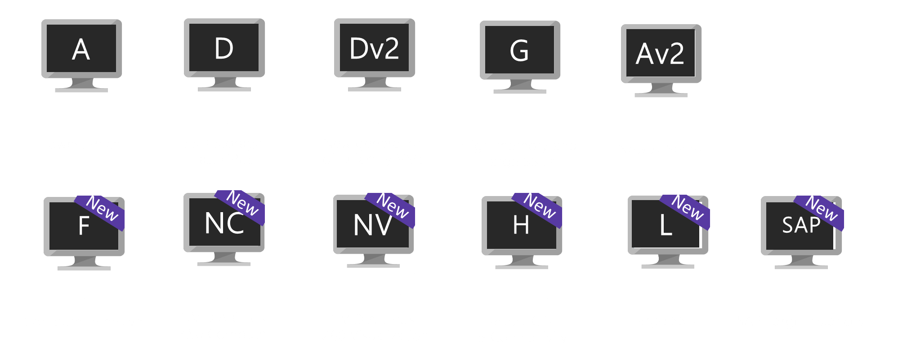
Hardware Innovation
Soon
Soon
Soon
Soon
Soon
M
Dv3
Ev3
ND
NCv2
Lv2
B
Fv2
Extremely
Large Memory
New generation of D family
High memory
Deep Learning
NVIDIA P40s
New gen of NC
NVIDIA P100s
AMD-based
Sizes
Burstable
Compute

Slide 18
IaaS Virtual Machines
Windows and Linux Virtual Machines provides on-demand, high-scale, secure, virtualized infrastructure using Windows Server
Come in different “Families” or “series” used to categorize their general function
For many partners, this is their cash cow
Use automation spin up/spin down as needed
Default pricing is on 24h x 31d, or 744 hours

Slide 19
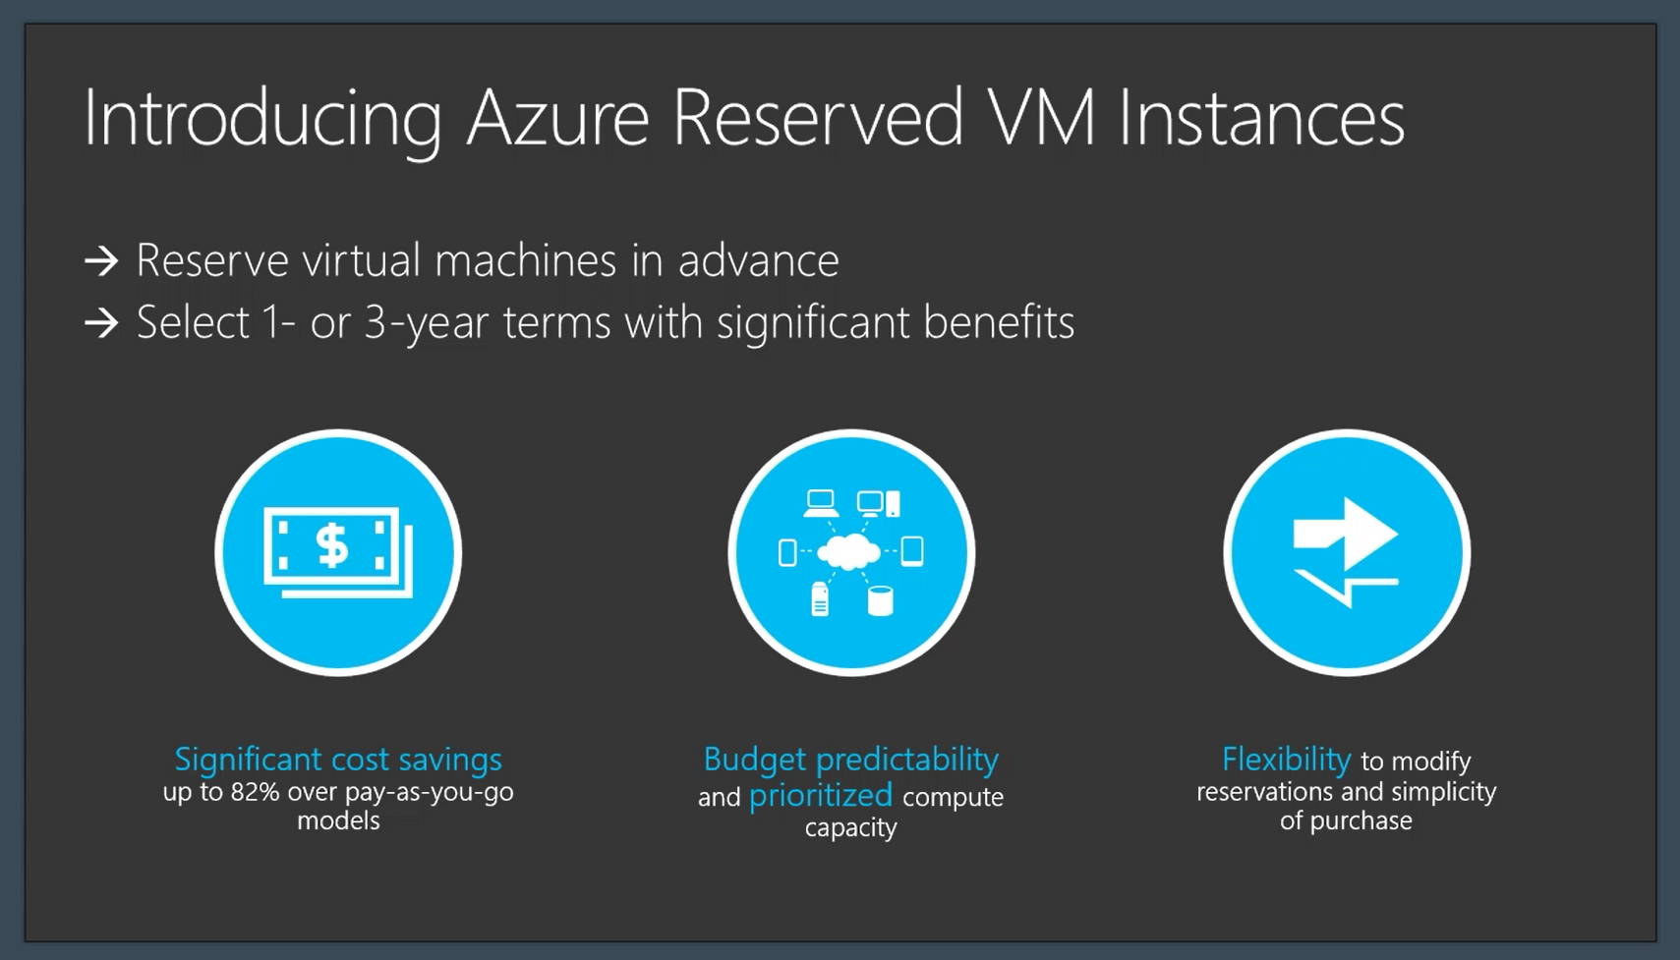

Slide 20
Azure protection options for all scenarios Introducing Availability Zones, protecting from datacenter level failures
Protection radius
Data Residency boundary
Availability Sets
High Availability protection from hardware failures in a datacenter.
Availability Zones
High Availability protection against hardware, network, cooling, and power failures within a region.
Region Pairs
Protection for your data and applications from the loss of an entire region with GRS backup and Azure Site Recovery.
Hardware
Datacenter
Region

Slide 21
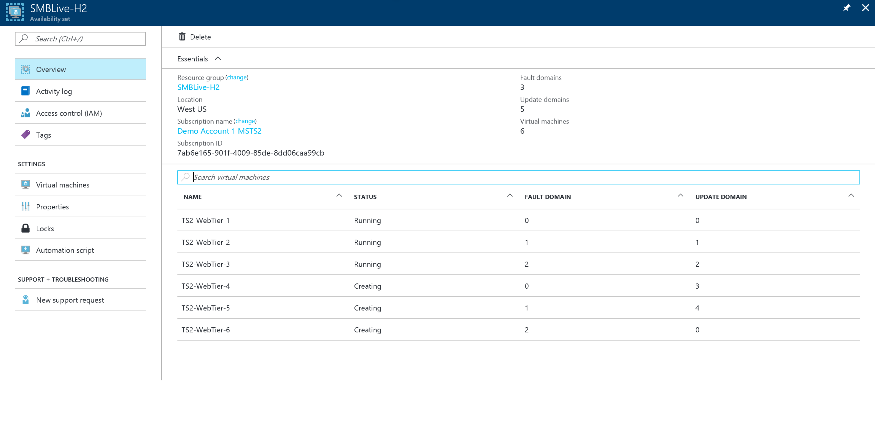
Availability Set

Slide 22
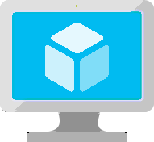
VM Scale Sets
Manage identical VMs at Scale
High performance provisioning of 1-1000 VMs
Auto-configuration at scale
Auto-scale based on schedule and resource metrics
Easy updates at scale
Managed Disk support
Single ARM resource
Notes:
So, VMs are great… but managing a lot of them individually can be hard. That’s where VM scale sets comes in..
The goal here is to enable management of like VMs as a group and make it easy to scale them in/out based on demand.

Slide 23
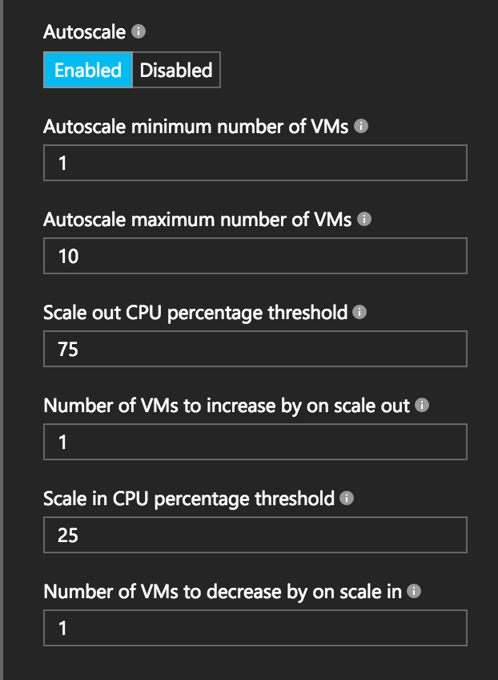
Autoscale with VM Scale Sets
Define Max – Min VMs
Define trigger and action rules
Standard audit / email notifications
Define webhooks for custom notifications and actions (e.g. runbooks)
Notes:
Metrics emitted by Azure Diagnostic Extension
Triggers can be basic performance metrics, and also schedule based, queue length based.

Slide 24
Azure Networking

Slide 25
The big (network) picture
Virtual network
“Bring your own network”
Segment with subnets and network security groups
Control traffic flow with user defined routes
Azure
virtual network
Users
Internet
Front-end access
Dynamic/reserved public IP addresses
Direct VM access, ACLs for security
Load balancing
DNS services: hosting, traffic management
DDoS protection
Backend connectivity
ExpressRoute VPN Gateways
Backend connectivity
Point-to-site for dev/test
VPN Gateways for secure site-to-site connectivity
ExpressRoute for private enterprise grade connectivity
Notes:
The preview of a new Azure networking service called Azure DDoS Protection, which helps protect publicly accessible endpoints from distributed denial of service (DDoS) attacks. Azure DDoS Protection learns an application’s normal traffic patterns and automatically applies traffic scrubbing when attacks are detected to ensure only legitimate traffic reaches the service.

Slide 26
Azure Networking Services
Virtual Networks
Network security groups (virtual firewall)
Load balancers
Traffic manager (DNS)
Azure Load Balancer (transport layer, NAT)
Application Gateway
Network gateways
VPNs
ExpressRoute
Route table (custom routes inside vnet)

Slide 27
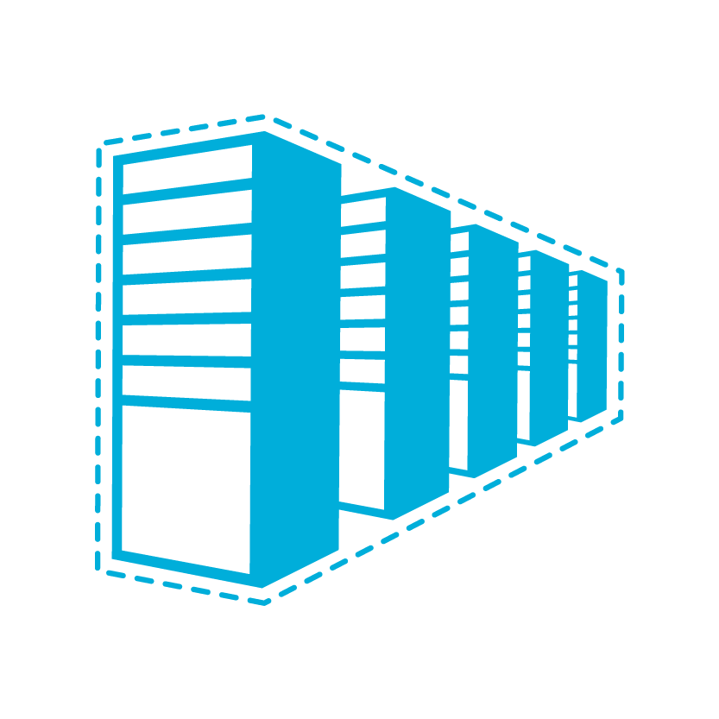


Connectivity Options to Azure
Cloud
Customer
Segment and workloads
Consumers
Access over public IP
DNS resolution
Connect from anywhere
Internet Connectivity
Developers
POC Efforts
Small scale deployments
Connect from anywhere
Secure point-to-site connectivity
SMB, Enterprises
Connect to Azure compute
Secure site-to-site
VPN connectivity
SMB & Enterprises
Connect to Microsoft services
Mission critical workloads
ExpressRoute private connectivity

Slide 28
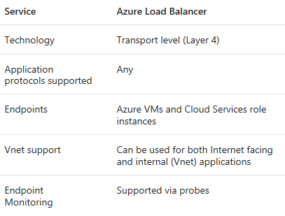
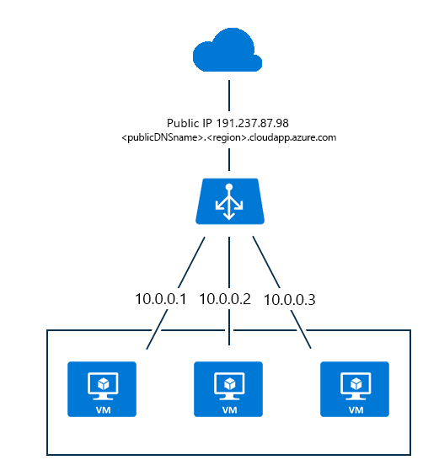
Azure Load Balancer

Slide 29
Let’s Take A Look
http://???/

Slide 30
Azure Storage

Slide 31
Azure Storage
Foundational Building Block of Azure
Azure Services: SQL Data Warehouse, HDInsight, Data Lake Store, Event Hubs, IoT Hubs…
Microsoft Services: Office 365, OneDrive, XBox, Skype…
Hyper Scale
>120 Trillion Objects, >30 million transactions per second
Durable
Never lose your data. Multiple redundancy options. Automatic data checks
Secure
Encryption at Rest. Client side Encryption. Integration with KeyVault
Highly Available
Fault tolerance to hardware/software issues. Automatic load balancing
Open
REST API, Open sourced Client Libraries – .NET, Java, C++, Python, Node.js, iOS, Android, Xamarin…
Hybrid
Extensive partner ecosystem. Azure Stack for private/hosted clouds.
Notes:
In addition, Azure Storage is also used by every Azure service directly or indirectly for data persistence and by nearly every MS services including O365 and Skype for Business on the enterprise side and OneDrive, Xbox and Skype on the consumer front
The Storage services have a number of capabilities that are common across the board…let’s go through each of them briefly.
Hyper Scale: In 60 min, ~6B net new objects, ~70B transactions, ~2.5PB of data ingressed/egressed. In 1 yr: 52T net new objects, 613T transactions, 21EB of data…but more than that since the growth rate is also increasing over time.
Durable: Multiple replicas with failure recovery and no data loss. One-click options for redundancy, including automatic geo-replication. Checksums and CRC scrubbing to protect against data corruption and bit rot
Secure: Wide variety of security options ranging from encryption at rest to easy client side encryption including key management with Azure KeyVault: Azure’s HSM as a service
Highly Available: We recover from disk, node and rack level failures without you having to worry about it. We scale up and down dynamically based on amount of read/write traffic to your data
Open: We are platform agnostic and have support for using Storage from a wide variety of languages and development environments including .Net, Java, Python and Node.js as well as mobile platforms including iOS, Android and Xamarin
Hybrid:
We have a wide variety of partners that integrate with Azure Storage including backup companies like Commvault and Veritas that provide on-prem to cloud backup and storage companies like NetApp and EMC that provide hybrid storage on-ramps from their arrays to Azure Storage. We work with a number of cloud first storage startups like Panzura, Nasuni, Softnas, Talon and more. In addition we have our own first party services that provide tiered experiences from servers including Azure Backup, Azure Site Recovery and StorSimple

Slide 32
Azure Storage Services
IaaS
PaaS
Virtual machines
Existing frameworks
Web and mobile
Microservices
Serverless Compute
Storage
Networking
Disks
Persistent disks for Azure IaaS VMs
Premium Storage Disks option: SSD based, high IOPS, low latency
Files
Fully Managed File Shares in the Cloud
SMB and REST access
“Lift and shift” legacy apps
Objects
Highly scalable, REST based cloud object store
Block Blobs: Sequential file I/O
Cool Tier Available
Page Blobs: Random-write pattern data
Append Blobs
Tables
Massive auto-scaling NoSQL store
Dynamic scaling based on load
Scale to PBs of table data
Fast key/value lookups
Queues
Reliable queues at scale for cloud services
Decouple and scale components
Message visibility timeout and update message to protect against unreliable dequeuers
Built on a unified Distributed Storage System
Durability, Encryption at Rest, Strongly Consistent Replication, Fault Tolerance, Auto Load-Balancing
Notes:
Cloud services and cloud usage are broadly defined as existing across infrastructure services or IaaS and higher layer platform services or PaaS. The Azure Storage services span both categories.
On the IaaS side we provide single instance storage for VMs in the form of our Disks service and SMB shared storage which we call Azure Files.
On the PaaS side we provide an unstructured object store called the Blob Storage service which offers Exabyte scale and the ability to store trillions of objects across different tiers within the cloud. Our current cloud object storage tiers are hot storage for higher performance and frequently accessed data and cool storage for active archives. In addition to unstructured data, we also have the NoSQL Tables service for semi-structured and structured data and the Queues service for reliable intra and inter-service communication.

Slide 33
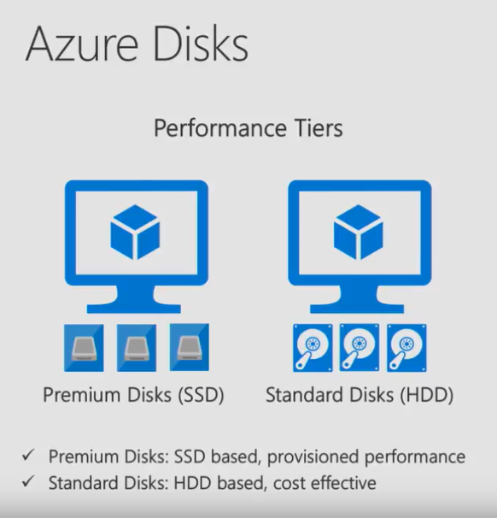

Slide 34
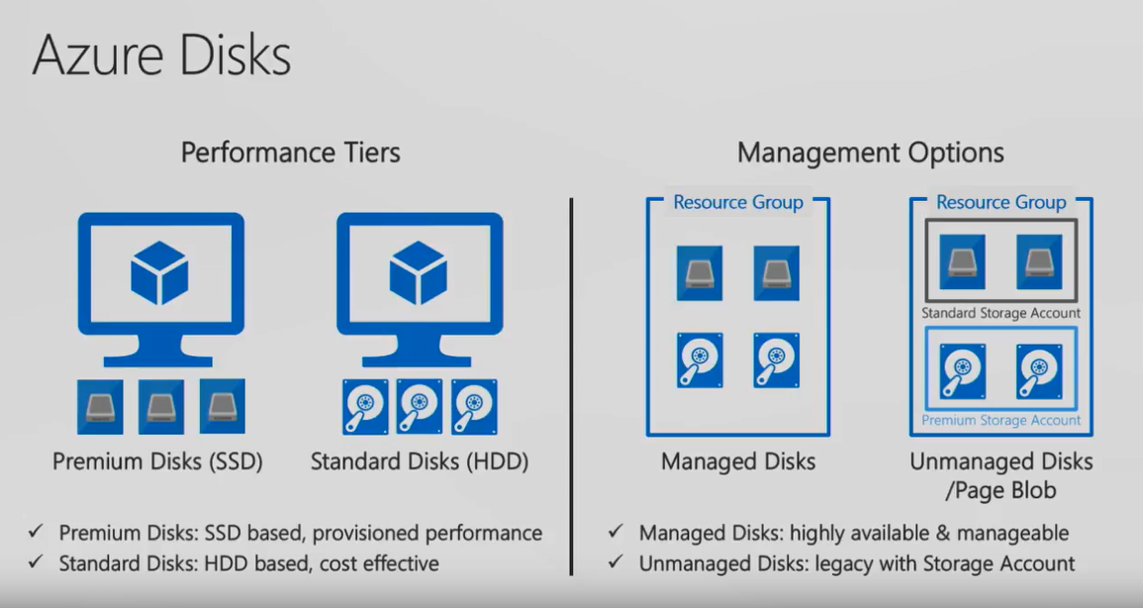

Slide 35
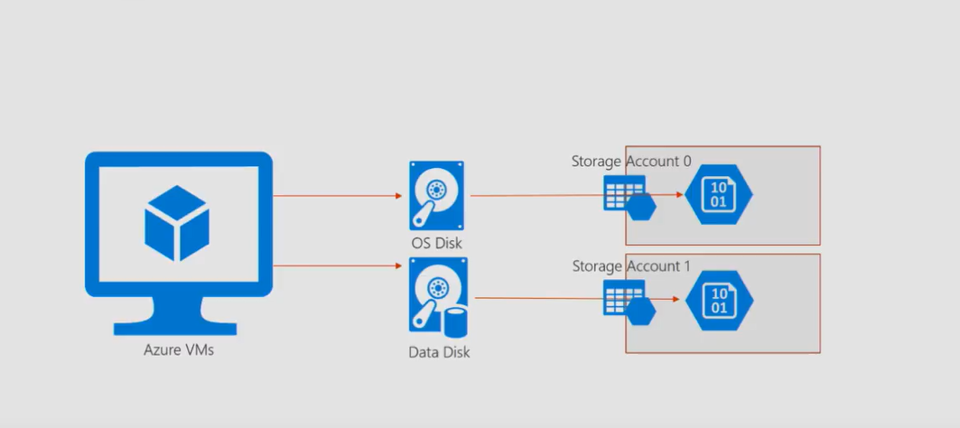
Unmanaged Disks

Slide 36
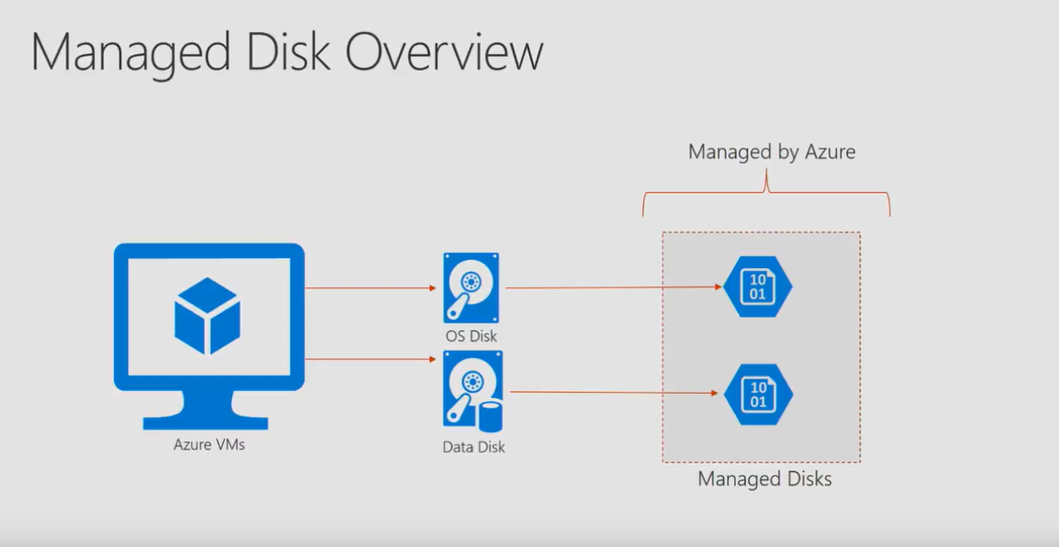
Managed Disks Overview

Slide 37
Using Managed Disks for HA
Managed Disks replace the need to have separate storage accounts for each VM
Easily Migrate unmanaged disks to Managed Disks
No longer have storage account limits (such as 20,000 IOPS/account)
Better reliability for Availability Sets
Better security by being able to utilize RBAC to assign specific permissions at disk level instead of storage account level
Two types – Standard and Premium
Standard disks are billed for the number of transactions
No cost for transactions for premium disks

Slide 38
Options for Highly Available VMs
Option 1 (Good $) – Using premium managed disks to get a single VM SLA
Minimum VM size is D1
Must use premium managed disk
Option 2 (Better $$)– Using availability sets
Can use lower tier VMs (A vs D)
Can use standard managed disk
Transactions costs will be calculated for standard disk types
Option 3 (Best $$$)– Using premium managed disk VMs in an availability set
Ultimate level of protection
No transaction costs on the managed disks

Slide 39
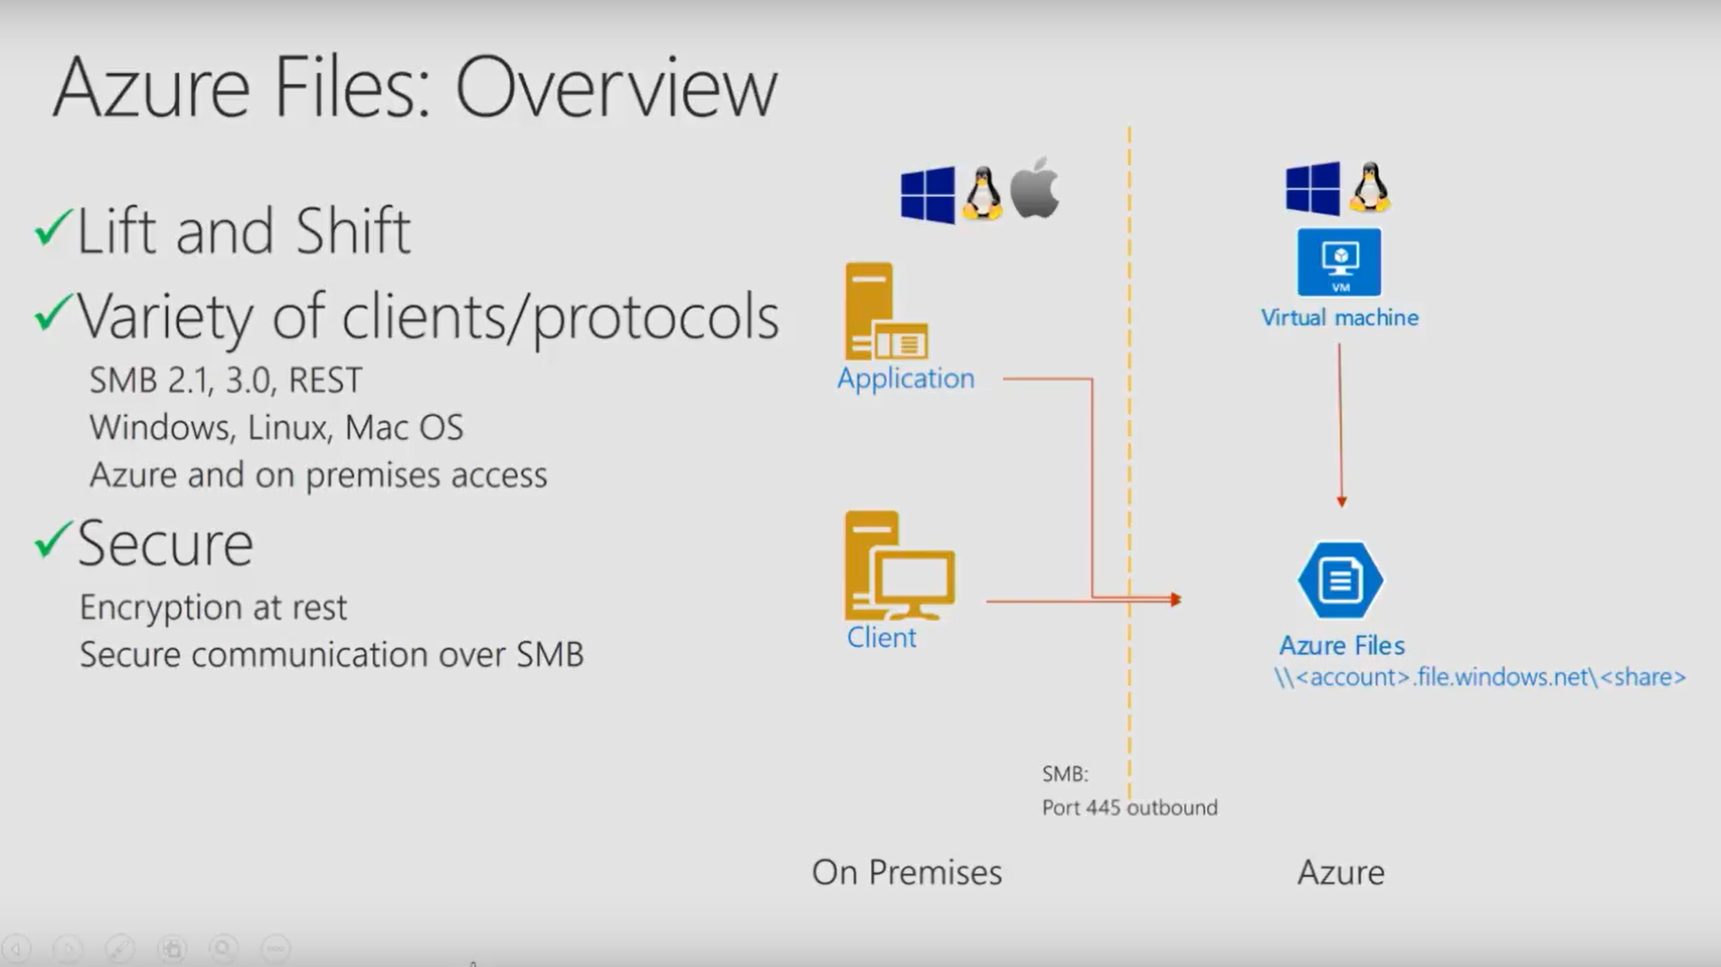

Slide 40
Quick Demo
Azure Files (SMB in the cloud)

Slide 41
Azure Files (preview features)
Files Sync
SyncAzure Files to local Windows server (or servers)
Use cloud tiering to store frequently accessed files locally
Less frequent files have stubs locally and are pulled down on demand
Snapshots
Snapshot image Azure SMB shares
Protect against data corruption, accidental deletes

Slide 42
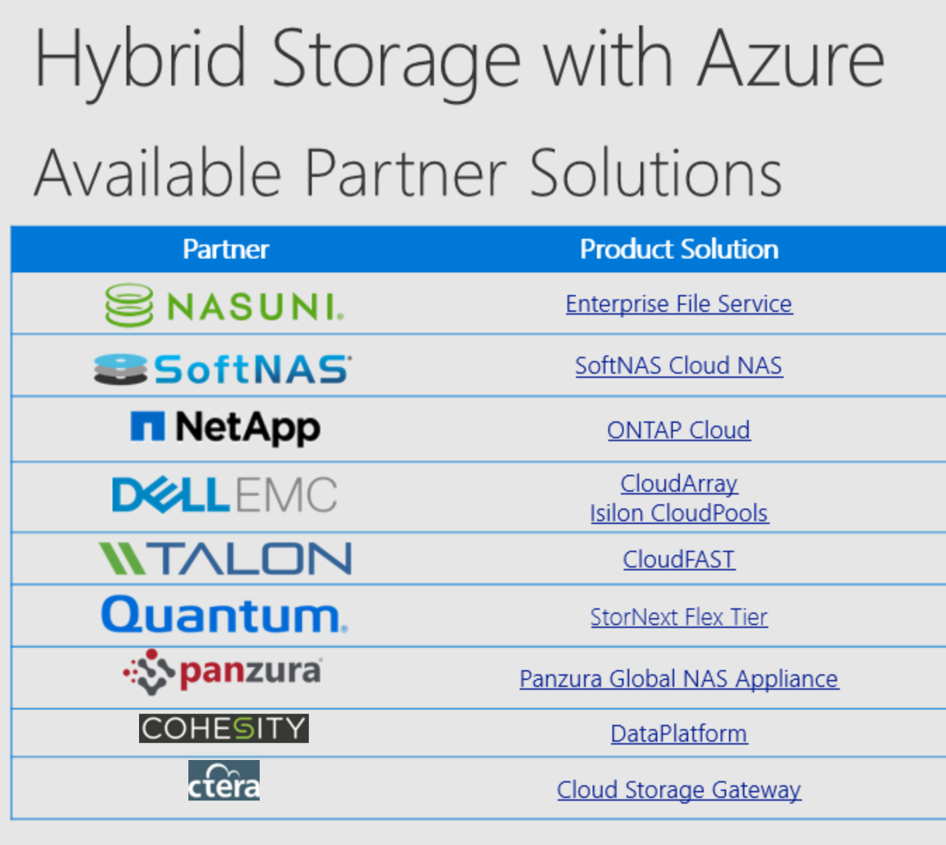
Notes:
A new enterprise NFS service, powered by NetApp. Building on the partnership with NetApp announced in June, Microsoft will deliver a first-party, native NFS v3/v4 service based on NetApp’s proven ONTAP® and other hybrid cloud data services, with preview available in early 2018. This service will deliver enterprise-grade data storage, management, security, and protection for customers moving to Microsoft Azure. We will also enable this service to advance hybrid cloud scenarios, providing visibility and control across Azure, on-premises and hosted NFS workloads.

Slide 43
Management and Monitoring

Slide 44




Azure structure
Account and enterprise agreement
Subscription(s)
Resource group
Resource group
SQL
SQL
Role-based access control
Tags
Azure Resource Manager policy
Templates
Notes:
Speaker notes:
When we talk about how we’ve done our Azure structure, we think about subscriptions. You want to lay out your subscriptions based on technology, the type of policy that you want to apply, and how your business is laid out. We use RBAC, which is role-based access control, to ensure that the right people have the right access to the right subscriptions. We want to make sure that people can operate their business, information remains protected, and people can’t make changes when they’re not supposed to.
The lower level is the concept of the resource group, an Azure construct that allows you to put the various resources associated with a single app into a resource group and then apply policy from Azure Resource Manager and tags. We use tags—key-value pairs—in Microsoft IT to identify the organization that it’s related to, the environment, and the app ID, a unique identifier. We can use these tags to associate different resources to a different app, organization, or environment, and then make business decisions based on that. Resources include web apps, Azure SQL Database, storage account, and so on.
Templates: We’ve created specific templates that internal teams can use to build out resources, and we ensure that they build them out according to our standards and policies. Templates enforce the creation of tags for tracking.

Slide 45
Organizing with Azure Resource Manager
Resource Groups
Container for multiple resources
Resources exist in one resource group
Resource groups can contain resources in different regions
Resource groups can contain different resource types
Tags
Name-value pairs assigned to resources or resource groups
Subscription-wide taxonomy
Each resource can have up to 15 tags
Flow through to billing

Slide 46
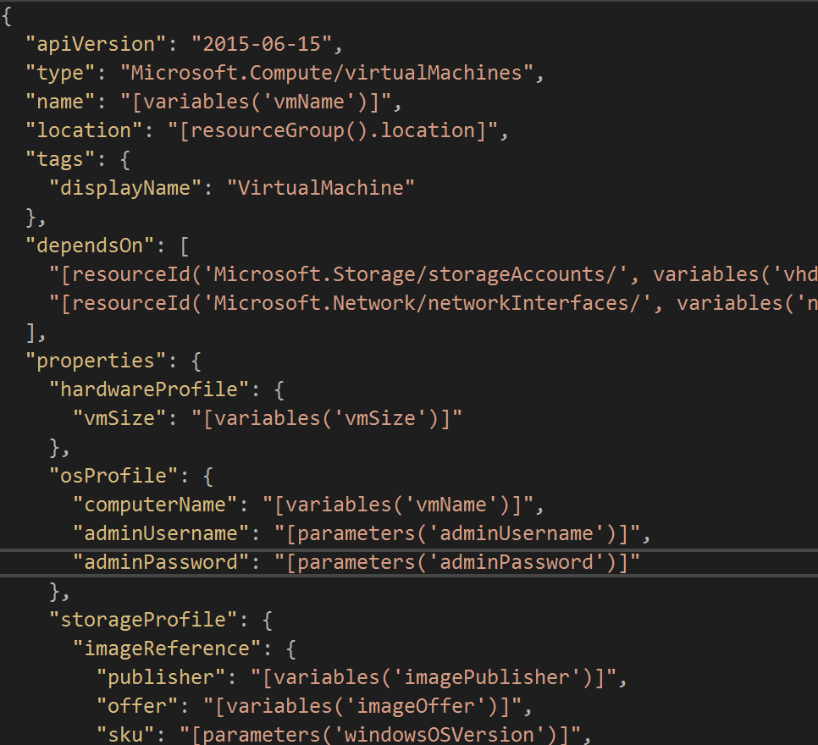
Infrastructure as Code
Treat IaaS as code
Languages - Powershell, .NET, CLI, Python
VM specs
VM Config
Package management
Network settings
Use automation / CI-CD tools
Powershell - DSC, Runbooks
OSS - Chef/Puppet, Jenkins
3rd party – Terraform, Ansible
Use Git or other repo to version

Slide 47
Demo
Using Visual Studio to build ARM templates
Powershell DSC
Deploying to Azure with Powershell / Visual Studio

Slide 48
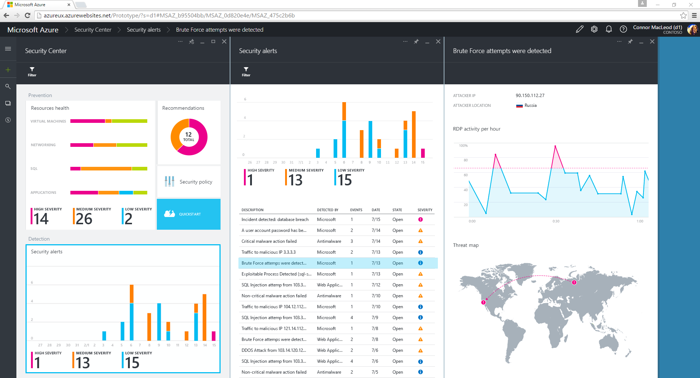
Azure Security Center
Monitor the security state of resources
Prioritized recommendations
Easily deploy partner security solutions
Security policies for subscriptions and resource groups
Central view of your security posture
Prioritized security alerts
Notes:
One-stop service for monitoring and managing the security posture of your environments.

Slide 49
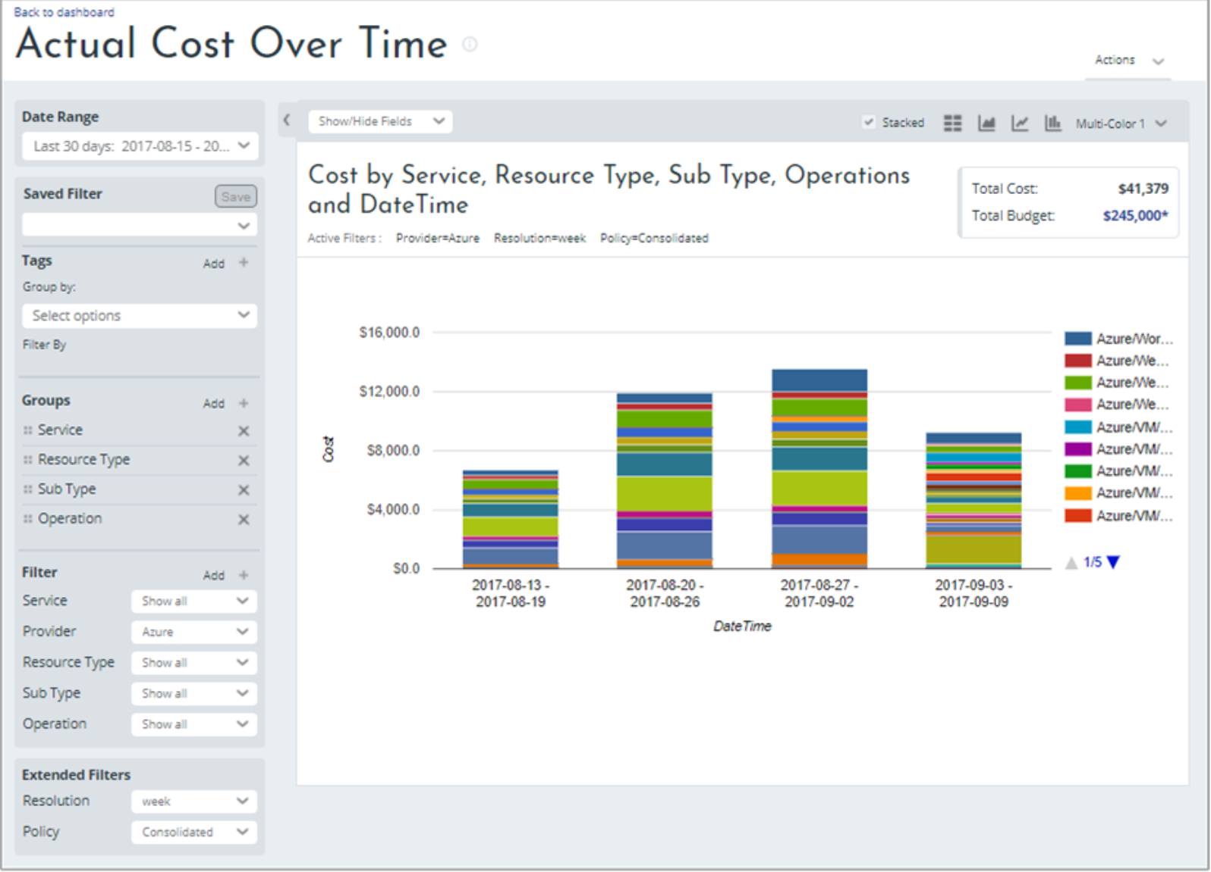
Cost Management (preview)
Metrics on cloud usage
Cost Optimization recommendations
Implement chargeback scenarios
Reports + dashboards

Slide 50

Azure solutions

Slide 51
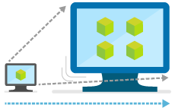
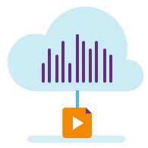

Typical starting points on IaaS
Web and mobile
Line of Business
Apps like SAP,
Sharepoint
Microservice apps
Dev and test
Big data and analytics
Internet of Things
Backup, recovery, and archive
High performance computing
Digital media
Notes:
Objective:
Azure provides a comprehensive dev platform for apps of all kinds – so what are the most common solutions customers are wanting to build?
Key talking points:
These represent some broad categories and include multiple sub genres:
Web and Mobile Apps
Digital marketing
E-commerce
Mobile
Business Apps
App modernization
SAP
SharePoint
Dynamics
Development and test
Backup, Recovery, and Archive
Backup and archive
Disaster recovery
Big Data and analytics
Business intelligence
Data warehouse
Internet of Things
Predictive maintenance
Remote monitoring
Microservice Apps
Digital media
High Performance Computing

Slide 52
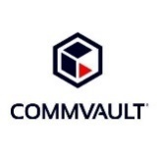


Backup, archive, and disaster recovery
Backup + Archive + DR
Dev/test
LOB apps
Dev/test
LOB apps
Backup+Archive+DR
Enables you to protect your data and apps no matter where they reside
Extend your on-premises backup storage and data
Protect your major IT systems against disaster
Azure storage
OMS Suite
StorSimple
Many more...
Azure
Azure Site
Backup
Recovery
Cost savings
Simplicity
Compliance
Save on backup and archival costs
Simplify the process of data archiving
Manage a remote branch office more efficiently
Meet your organization’s compliance goals
WS 2012
SC/DPM
Notes:
Key Benefits from Solution pages
Speaker Notes:
Azure Storage enables the value of Backup and Disaster Recovery to come to life.
The importance of backup and disaster recovery is well documented but most businesses only have around 25-30% of their mission critical workloads protected. This is often due to the expenses associated with running a secondary site and purchasing hardware to protect workloads. With Microsoft, you have access to robust backup and recovery solutions to ensure your apps and data are safe if a VM, or entire datacenter, goes down. But we cannot have a business continuity conversation without discussing the importance of the storage running on the backend. Azure Storage’s cost effectiveness, scalability and flexibility make it possible to protect your enterprise workloads and enable you to take advantage of all the benefits Microsoft’s business continuity services provide.
With Azure:
Protect vital data with automated backup to Azure Storage
Ensure business continuity with automatic recovery of critical applications
Use consistent tools for backup & recovery to local disk or Azure Storage
Ensure application-consistent backups so your data is not corrupted
Azure Storage makes all of this possible.

Slide 53







Azure Site Recovery: The Complete Disaster Recovery Solution
Site to Azure
Site to Site
Any Cloud
AWS*
Physical/VMware to VMware
VMware
Hyper-V
Physical
VMM to VMM
Any OS
Windows
Linux
Notes:
Site Recovery Benefits:
Automated VM level Replication
RPO of seconds and RTO of minutes
No impact DR Drills with Test Failover
Planned and unplanned failover
Orchestrated Recovery Plans for Disaster Recovery
Failback support
Migrate to Azure from anywhere
Create on-demand test copies in Azure

Slide 54
Azure Migrate (Lift n Shift)
Azure Migrate (preview)
New agentless discovery tool to audit infrastructure
Suggests optimal VM sizes for discovered assets
Identifies dependencies among VMs
Flags workloads that wont migrate or that have nuances to migration
Microsoft Assessment and Planning Toolkit (MAP)
Available now
Run in your environment to generate discovery reports and accelerate your migration projects
Azure Pricing Calculator
Pricing calculator
TCO calculator

Slide 55
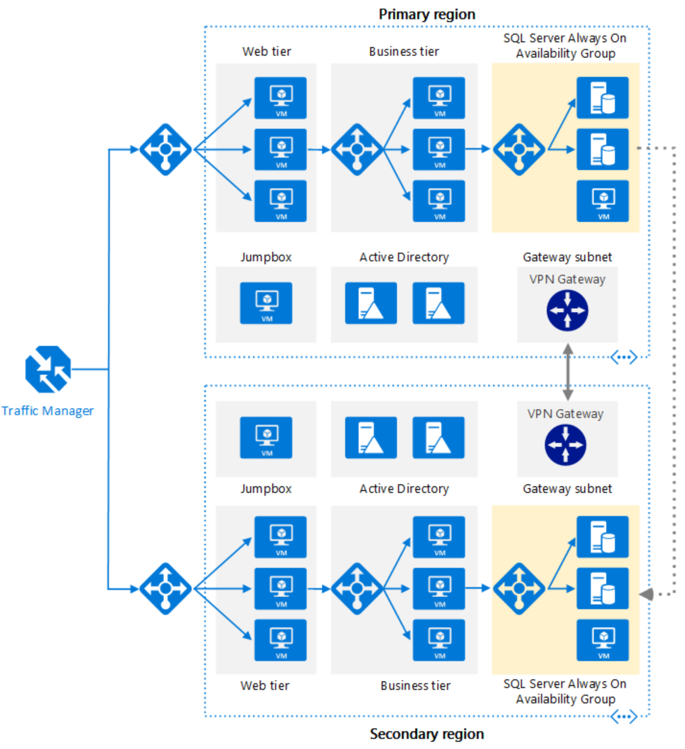
Reference Arch.
Geo-redundant app
Multiple Azure regions
Load balanaced
Traffic manager (DNS)
Azure LB (transport layer)
HA
Tiers in availability Sets
Scalable
VM Scale Sets for web/business tier

Slide 56
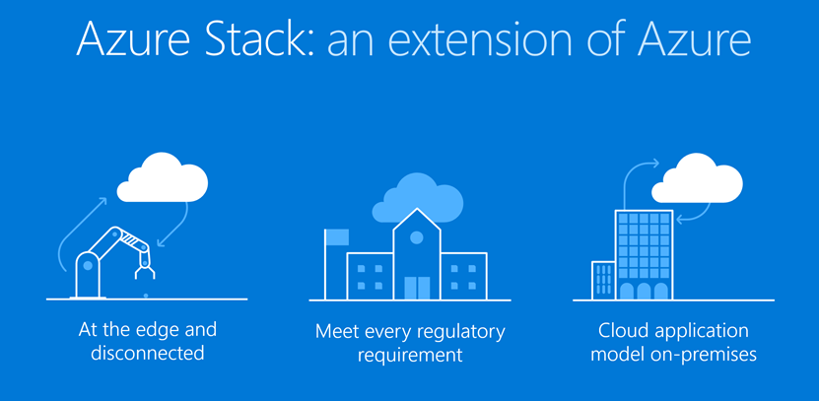

Slide 57
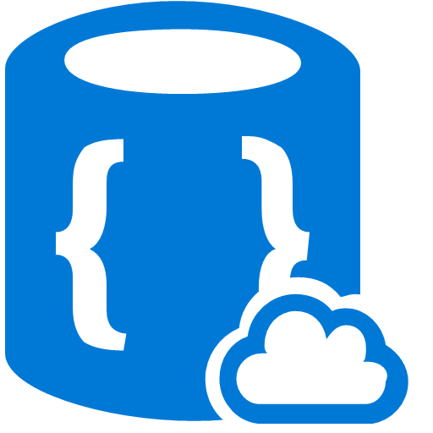


Use Azure Stack for:
Real-time latency requirements
Connectivity issues
Local data processing
Use Azure for aggregate analytics and big data modelling
Common application logic across both, connected, or disconnected
Aggregated analysis
Data collection
Local data processing
Azure Stack
Azure Stack
Azure Stack
Limited or no connectivity
Edge and disconnected solutions
Notes:
Edge and disconnected solutions:
You can address latency and connectivity requirements by processing data locally in Azure Stack
and then aggregating in Azure for further analytics, with common application logic across both.
We’re seeing lots of interest in this Edge scenario across different contexts, including factory floor, cruise ships, and mine shafts.
Our case, planes, boats, embassies, field offices.

Slide 58

Develop and deploy global application in Azure
Optionally deploy to Azure Stack to handle customer preferences for regulations:
Government
Industry
Region
No changes to application
Azure
Country #1
App
Country #2
Country #3
Cloud applications to meet varied regulations
Notes:
With Azure Stack customer can EXTEND AZURE to meet specific regulations.

Slide 59


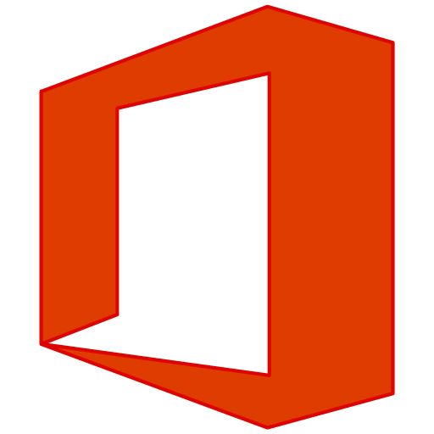

What Azure Stack is not?
Virtual Machine Dispenser or VDI Platform
Office 365 Hosting Platform
An Azure Replacement
Azure Stack is not a competitor to VMware (or VDI), Hyper-V on Server 2016 is.
Customers cannot host Office 365 on Azure Stack
Many services are not available on Azure Stack that are available in Azure
Azure Application Insights

Slide 60
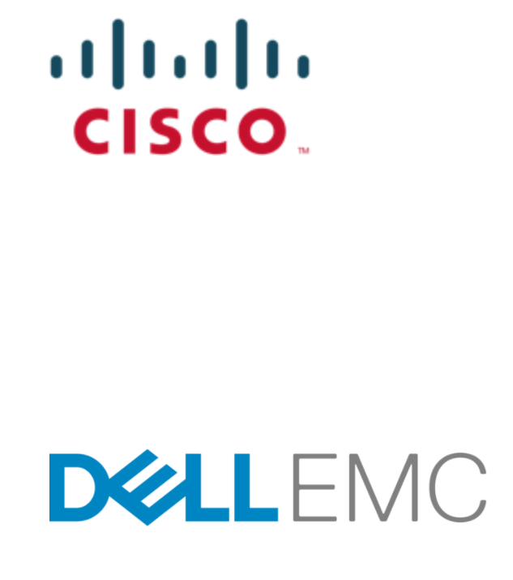
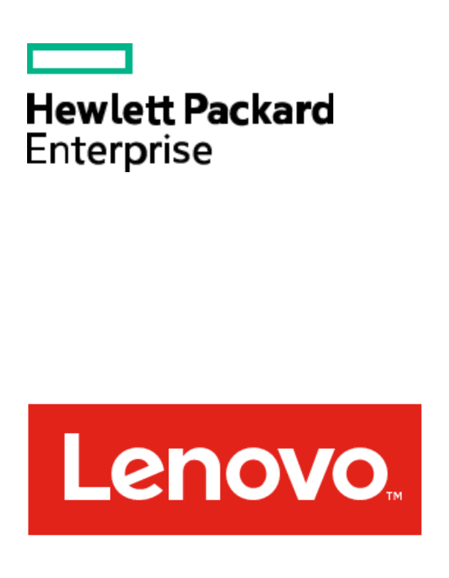
Purchased as an integrated system
Azure
services
Billed by Microsoft via EA or CSP,
support via Premier or Azure agreement.
Support
One integrated experience.
Hardware
Purchased directly from hardware partners, including support and installation services.

Slide 61
Pay-as-you-use model
Extension of Azure business model
Fee for consumption: only pay for services running on Azure Stack
No upfront licensing fees: don’t pay until you use the service
Compatible with Azure: same subscriptions, monetary commitment, invoice
EA and CSP channels
Azure Stack
Hosted and On-premises

Slide 62


THANK YOU

Slide 63
Resources for you
Azure Interactive Guide
http://azureinteractives.azurewebsites.net/
Azure Free Account - $200 of Azure Credits
https://azure.microsoft.com/en-us/free/
Partner Technical / Pre-Sales training
https://aka.ms/BuildIntelligentCloud
Visual Studio / MSDN Azure Sub – up to $150/mo
https://azure.microsoft.com/en-us/pricing/member-offers/msdn-benefits-details/
Azure Roadmap
https://azure.microsoft.com/en-us/roadmap/

